Slide 1

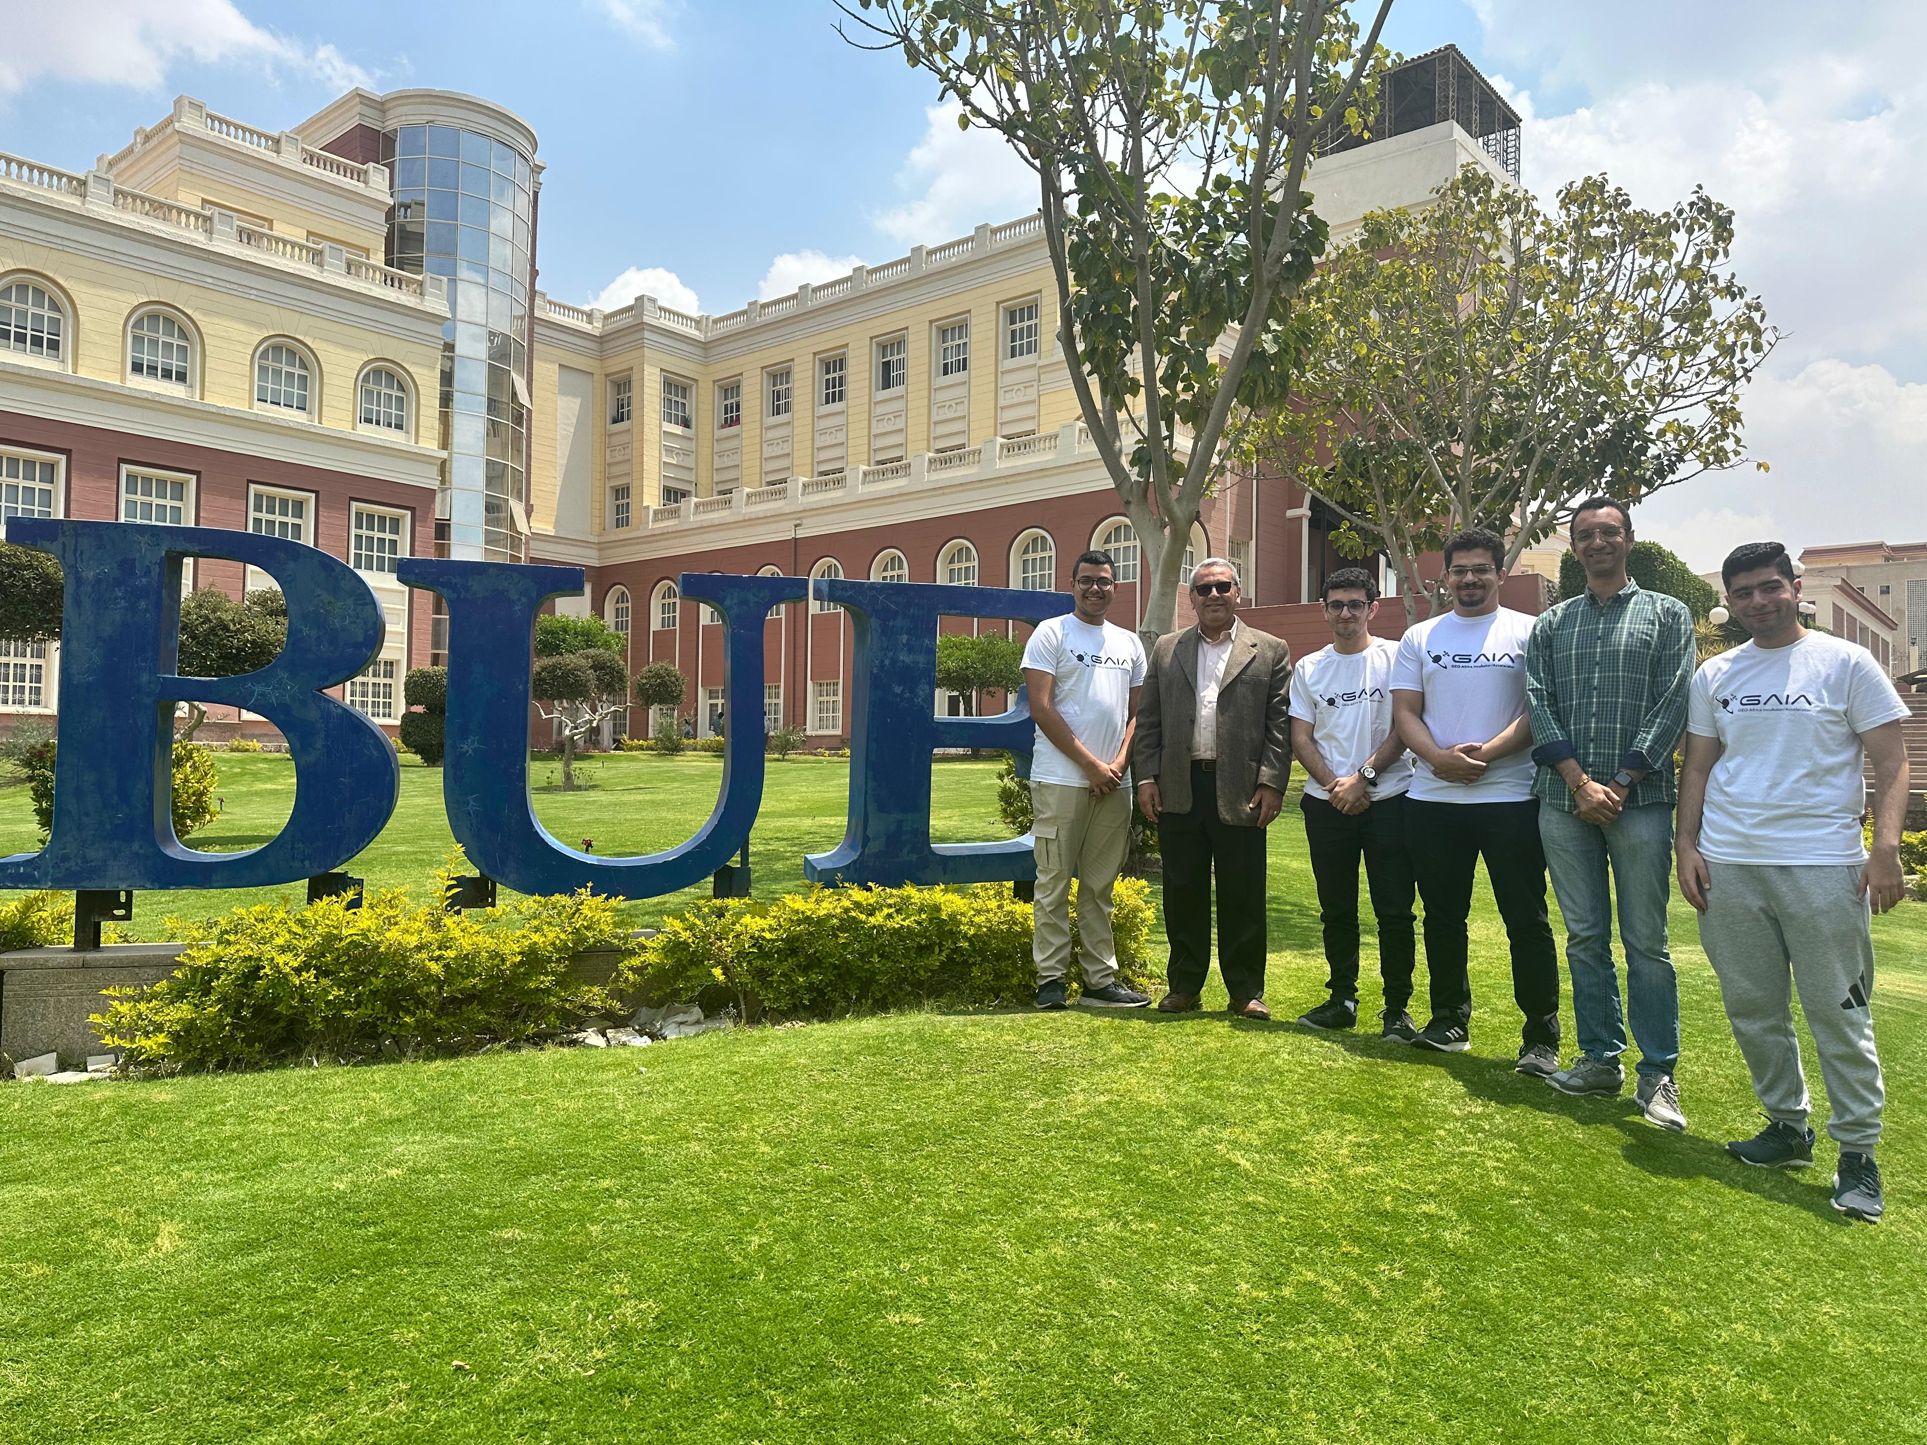
AfriBot Fire Patrol
IOT-Enabled Smart Systems
Project Title:
Fire detection and monitoring system
Members:
Mohamed Said (Leader) Abdalrahman Al-Masri Ahmed Asim Moaz ElSayed

Slide 2
Problem Statement
Forest and agricultural fires pose a significant threat to ecosystems, wildlife, and human communities. Early detection and rapid response are critical to minimizing damage, but traditional monitoring methods (satellite imaging, manual patrols) often suffer from delays, limited coverage, or high costs. There is a pressing need for an autonomous, real-time monitoring system that can detect fires and other irregularities in remote areas and immediately alert authorities to prevent large-scale disasters.

Slide 3
Problem Statement: Case Studies
1. Egypt- Siwa Oasis Farmland Fires
A fire in Egypt’s Siwa Oasis destroyed 10 acres of farmland, devastating local farmers and highlighting the risks of uncontrolled blazes in arid regions. An IoT fire monitoring and evacuation system could have prevented this disaster by deploying sensors on patrol vehicles to detect fires in real time. Early detection would allow farmers and fire brigades to respond before the fire spreads, while automated alerts could guide evacuations and direct water resources efficiently.
2. Madagascar- Wildfires Threatening Biodiversity
Madagascar’s wildfires, intensified by climate change and slash-and-burn farming, are threatening critical ecosystems like Ranomafana National Park. An IoT-equipped vehicle could enhance fire monitoring by using onboard sensors for real-time fire detection in remote forests. With GPS capabilities, the vehicle could map fire spread while providing rapid alerts to Fire fighters and local communities. As Madagascar is a global biodiversity hotspot, this IoT vehicle is crucial for early fire detection, protecting endangered species, and minimizing ecological damage.

Slide 4
Proposed Solution Overview
We propose an autonomous surveillance vehicle designed to monitor forest and agricultural environments for early signs of fires. Equipped with environmental sensors and cameras, the car patrols specific areas, detecting fire indicators such as flame, sudden temperature spikes, or gas emissions. Upon detection, it sends real-time alerts to authorities, enabling rapid response before the fire spreads uncontrollably. This mobile solution offers a cost-effective and flexible alternative to static watchtowers or expensive drone systems.

Slide 5
Different IOT sensors and devices will be integrated to monitor and process different signals and data. Sensors like Temperature, gas and flame are used to monitor different fire variables that will provide signals and data to analyze the current environmental condition.
PROPOSED SOLUTION
By implementing AI to identify human silhouettes to notify emergency personnel, as it also provides helpful data to identify high-risk areas, helping authorities make smarter plans and take preventive actions to reduce the chances of future fires.
In addition, Earth Observation data could be used to identify higher risk areas in which the vehicle will be deployed to ensure efficient and optimized monitoring. This system could be used by governments and local authorities to quickly spot forest fires before they get out of control. By getting alerts in real-time, authorities can react faster and take immediate actions to protect nearby communities, and reduce damage to nature. .

Slide 6
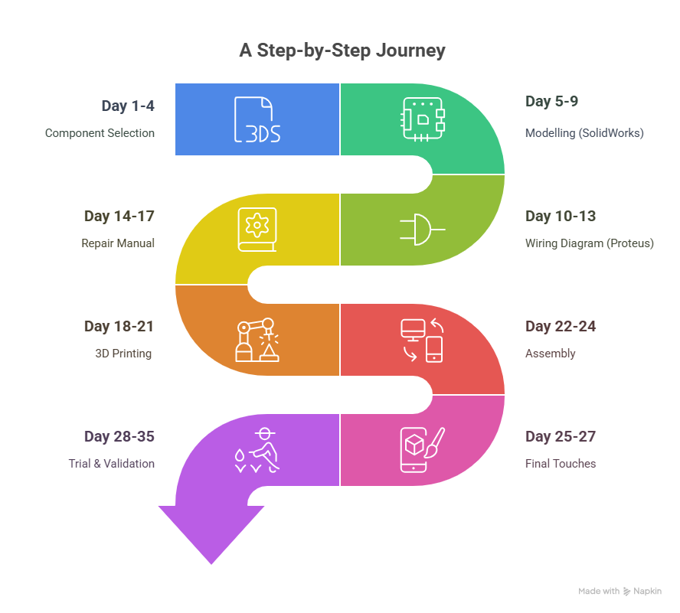
Roadmap Implementation
23 May – 27 June
35 Days

Slide 7
ROADMAP
Day 1-4 Component Selection
This stage Focuses on choosing the required components for the system including Microcontroller ,sensors , and actuators
Day 5-9 Modelling (SolidWorks)
During this phase, a 3D model of the vehicle will be designed using SolidWorks
Day 10-13 Wiring Diagram and Code Development
The electrical Wiring of the System will be designed using proteus to prevent any wiring errors during assembly
Writing ,testing ,and debugging the control code for the system , covering sensor integration , motor control , and IOT communication
Day 14-17 Repair Manual
A repair manual will be useful to guide troubleshooting and maintenance, listing the component specifications, Wiring, and connections
Day 18-21
3D printing the Vehicle based on the SolidWorks Model
Day 22-24
All Components at this stage will be assembled, creating a functional prototype
Day 25-27
Final Adjustments are made, such as IOT communication setup and sensor placements
Day 28-35
The final stage is where the prototype undergoes extensive testing to validate its performance and overall functionality

Slide 8
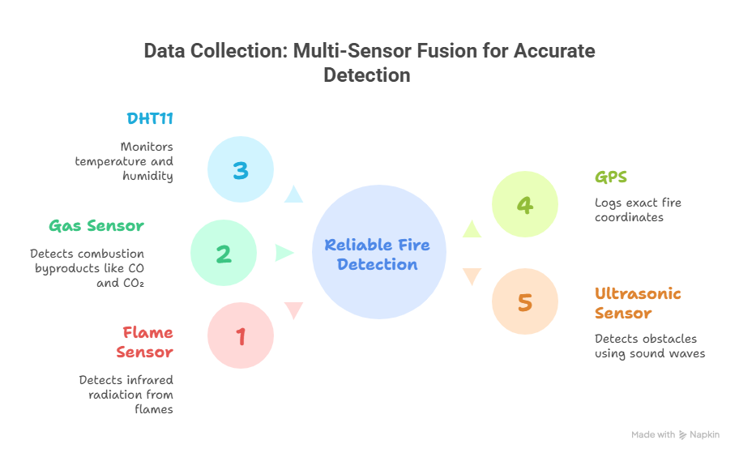
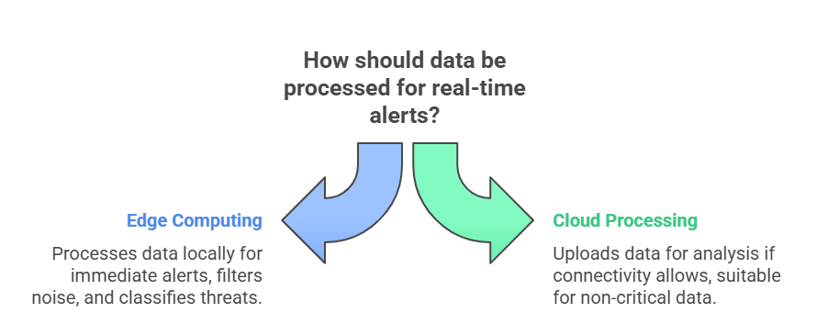
Data and Technology Utilisation

Slide 9
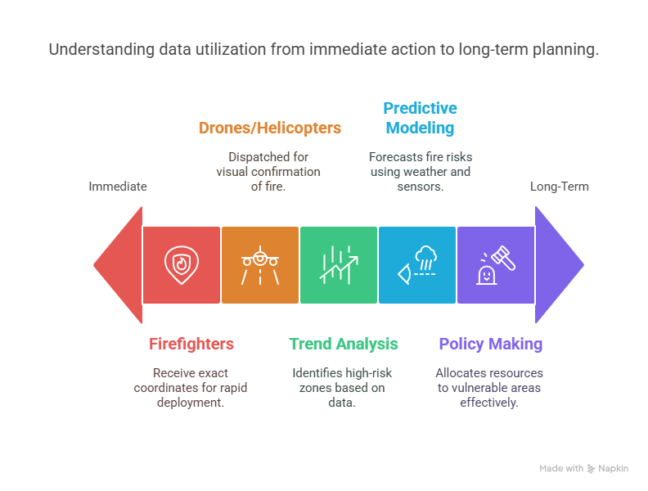
Data and Technology Utilisation

Slide 10
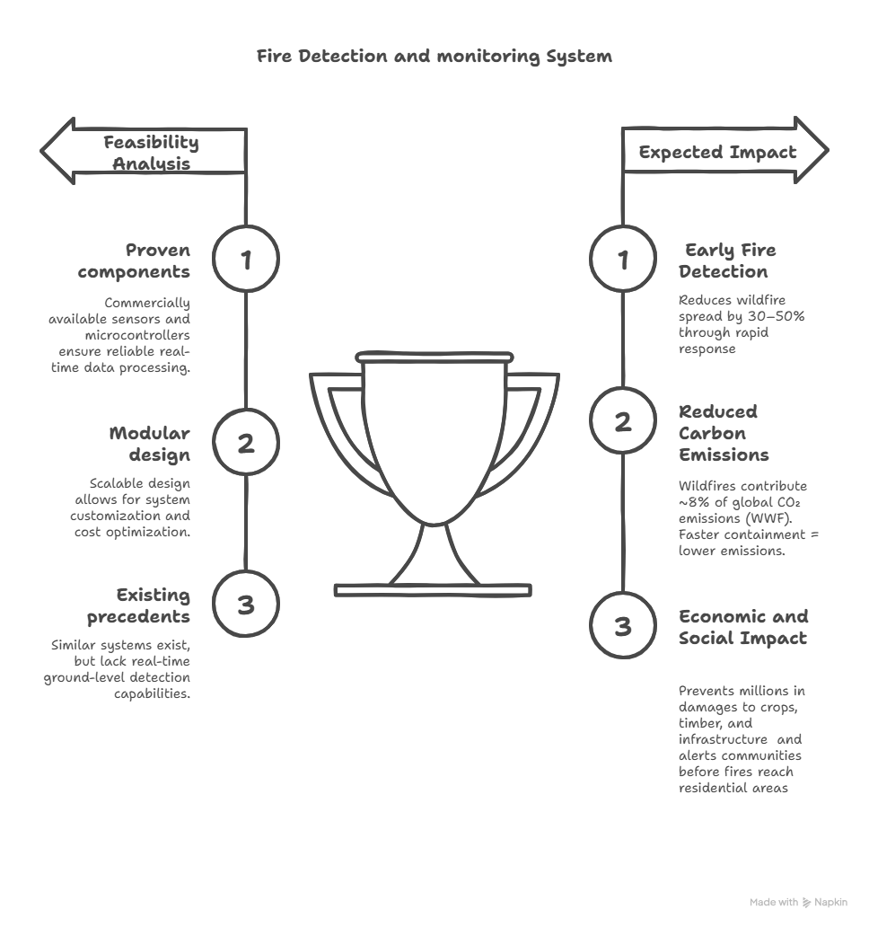
Feasiblity and Expected Impact

Slide 11

Final Submission Alignment
CHALLENGES AND RISK MITIGATION STRATEGIES
Our project will incorporate real-life feedback from sensor readings as well as dashboard-based actuators.
The prototype hardware schematics will be designed through SolidWorks and checked for tolerances and perfect fits.
These steps will ensure that the project adheres closely to the required submission guidelines
🛠 Sensor Inaccuracy – Risk: False readings from dust, weather, or animals – Solution: Use sensor fusion + data validation algorithms
📶 Connectivity Issues – Risk: Poor signal in remote areas disrupts alerts – Solution: Use long-range protocols (LoRa/Zigbee), store & forward data
🔋 Power Supply Limitations – Risk: Battery drain during long patrols – Solution: Add solar charging & optimize patrol routes
🌲 Rough Terrain Navigation – Risk: Vehicle gets stuck or damaged – Solution: All-terrain design + obstacle detection sensors
🔐 Data Security Threats – Risk: Data interception or tampering – Solution: Use encryption & secure authentication

Slide 12
Conclusion
In conclusion, the Fire Detection and Monitoring System project addresses a critical environmental and public safety issue: the early detection and rapid response to forest and agricultural fires. By leveraging an IoT-enabled autonomous vehicle equipped with advanced sensors (temperature, gas, smoke, flame) and real-time GPS tracking, the proposed solution offers a reliable and efficient method to monitor large, remote areas with minimal human intervention. The system's ability to provide immediate alerts and precise location data to emergency authorities enables faster action, reducing potential damage to ecosystems, wildlife, and nearby communities. Through thoughtful integration of hardware components, detailed modeling and assembly processes, and rigorous testing, this project demonstrates both technical feasibility and practical impact. Furthermore, we are fully committed to successfully complete this project. Our focus will be on constantly improving the system , making it reliable, efficient, and practical for real use. We aim to create a solution that is not only scalable but also impactful in enhancing fire detection and response

Slide 13
Bill Of Material
part number | part name | Description | units | unit cost(egp) | cost(egp)
1 | DC motorwith encoder | 25GA370(7.8kg/cm) | 4 | 650 | 2600
2 | wheels |  | 4 | 120 | 480
3 | motor drivers |  | 2 | 80 | 160
4 | flame sensors |  | 4 | 30 | 120
5 | ultrasonic sensor | HC-SR04 | 1 | 40 | 40
6 | smoke sensor | MQ2 | 1 | 95 | 95
7 | temperature sensor | DHT11 | 1 | 50 | 50
8 | servo motors | sg90 | 1 | 85 | 85
9 | batteries | 12v,3000 mAh | 3 | 1,250 | 3750
10 | esp32s/arduino | main microcontrollers | 2 | 275 | 550
11 | esp-CAM | camera microcontroller | 1 | 575 | 575
12 | wires |  | 150 | 0.75 | 112.5
13 | pipes |  | 1.25 | 15 | 18.75
14 | breadboards |  | 3 | 45 | 135
15 | LCD |  | 1 | 115 | 115
16 | buzzer |  | 1 | 7 | 7
17 | 3d-printing |  | 1 | 2000 | 2000
18 | GPS | neo 7m | 1 | 650 | 650
TOTAL (egp) |  |  |  |  | 11543.25
TOTAL (USD) |  |  |  |  | $230.87

Slide 14
THANKS!
moh.s8707@gmail.com
ahmed972003a@gmail.com
a4almasri@gmail.com
moazzelsayed102@gmail.com
The British University In Egypt

